Slide 1
Undergraduate Politics Dissertation Workshop
Workshop Week

Slide 2
Today’s Agenda
What is a dissertation?
Working with your supervisor
Research topics and research questions
Concepts
Literature reviews
Research methods
Writing your dissertation
Assessment criteria

Slide 3
What is a Dissertation?
A long piece of written work (8,000–10,000 words) that offers a detailed, sustained and critical treatment of a chosen topic
Differs from an essay in requiring greater depth of analysis and wider consultation of sources and materials (primary and/or secondary)

Slide 4
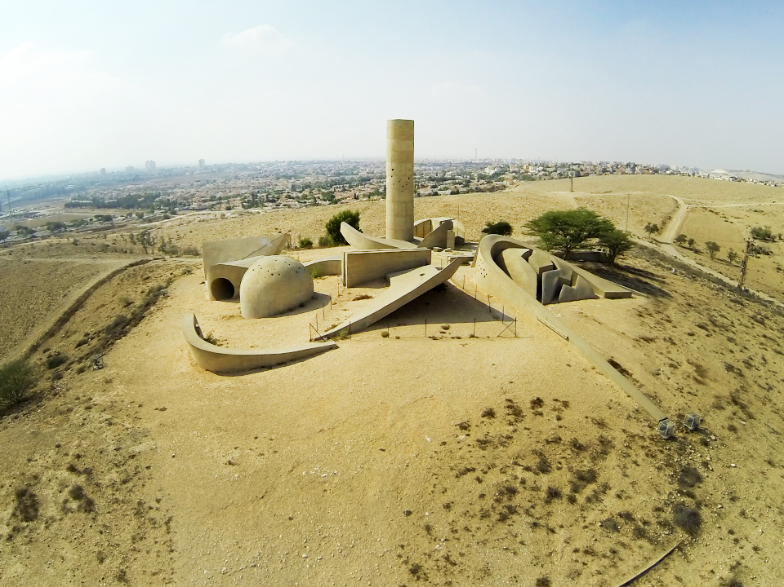

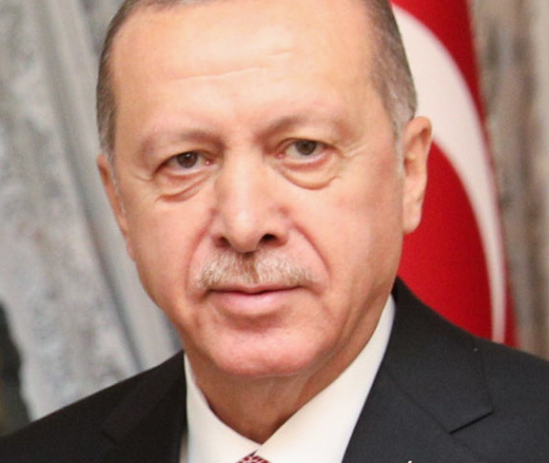

Some Examples

Slide 5
Supervisors
Supervisors offer guidance and support, but not direction
They can advise you on approach, coverage, questions to be asked and the outline structure and research design
They cannot comment on drafts
3 meetings before the end of Spring term
It is your responsibility to arrange meetings

Slide 6

Research Topics and Research Questions
Research Topic
The overall field in which you are researching
If you are focussing on a particular event, movement, idea etc, consider what it is a case of
Research Question
Make sure you have a question that you can clearly express
Your dissertation should focus throughout on answering the question

Slide 7
Research Questions: Examples
Why has membership of the Labour Party increased substantially in recent years after years of decline?
Why do some left-wing militant groups turn to urban terrorism when significant pressure is applied, while others do not?
How does public sculpture contribute to the construction of nationalism in Israel?
How has the experience of political power changed how democracy is discussed by the AKP in Turkey?

Slide 8
Discussion 1
What is your research topic?
What is your research question?

Slide 9
Concepts
It is important to identify the key concepts in your research topic/question
Make sure you understand existing conceptual debates
Be clear about how you use the concepts in your argument
Don’t be afraid to criticise how concepts are used in the current literature
Think about operationalisation: how do you turn an abstract concept into something we can measure?

Slide 10
Key concepts: Examples
Party membership, populism
Terrorism
Nationalism
Democracy

Slide 11
Discussion 2
What are the key concepts in your research design?
How will you operationalize your concepts?

Slide 12

Literature Reviews
What research has already been done on your topic?
What are the key theories and debates?
What is missing from the existing literature and how will your dissertation contribute?
How to find relevant literature
Reading lists for modules you have taken
Libraries: Birkbeck and Senate House
Google Scholar
Look at the literature reviews of recent articles on your topic

Slide 13
Literature reviews: Examples
Cartel Party Thesis, quantitative studies
Instrumental theories of terrorism, studies of other terrorist groups
Ethno-symbolist approaches to nationalism, studies of nationalism in Israel
Political theory debates on conceptualising democracy, studies of elite discourse on democracy in other countries/regions

Slide 14
Discussion 3
What are the key theories you need to engage with?
What other studies have been done which might be relevant for your research?

Slide 15
Research Methods
For empirical dissertations, many different kinds of methods could be used, for example:
Case studies
Interviews/focus groups
Surveys
Data analysis
Discourse analysis
Archives
For political theory dissertations, critical reading of key texts and conceptual argument are the main methods
Ethics
If human participants are involved (eg being interviewed or surveyed), you need to complete an ethics form and send it to your supervisor

Slide 16
Research Methods: Examples
Focus groups and a survey
Case studies based on news reports and published writings by militant leaders
Case studies based on news reports and art history books
Discourse analysis of President Erdogan’s speeches

Slide 17
Discussion 4
Which method(s) will you use in your project?
What sources will you use, or which people will you survey/interview?

Slide 18

Writing Your Dissertation
Introduction
Theory
Literature Review
Methods
Results
Analysis/Discussion
Conclusion

Slide 19
What To Avoid
Procrastination
Excessive description
Poor definition of the question
Loose or opaque structure
Poor integration of theoretical and empirical material.
Poor contextualisation, grounding in the literature
Uncritical use of sources
Sloppiness, poor presentation

Slide 20
Assessment Guidelines
the research question is well-defined, and contextualised
an argument is specified, coherently presented and supported by evidence
alternative arguments are analysed
the approach is critical, not descriptive
a relevant methodology is employed
relevant sources have been consulted
knowledge of relevant literature, issues and debates is demonstrated
the style and presentation is clear and careful, and appropriate academic conventions have been observed

Slide 21
Submitting Your Dissertation
Deadline: 27th April 2020
Electronic submission via Moodle by 12.00pm (midday)
Hard copy submission to the Politics Departmental Office at 10 Gower Street between the hours of 10.00am and 6.00pm

Slide 22

Any Questions

